Slide 1


Java SE(Core java)
Lecture-30

Slide 2
Today’s Agenda
01
String Handling
02
Different classes to handle String
03
Constructors and Methods of class String
05

Slide 3
String Handling
• Java provides 3 classes to handle Strings as per situation, these are
1. String
2. StringBuffer
StringBuilder
*StringBuilder will be covered in the Multithreading chapter.

Slide 4
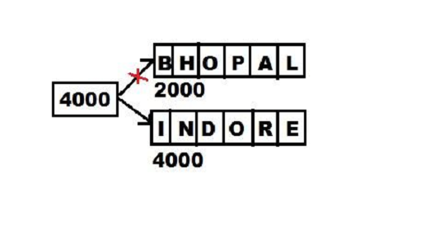
String class
• String objects in java are immutable i.e. content once stored cannot be changed.
• For Example,
String city=“Bhopal”;
System.out.println(city);
city=“Indore”;
System.out.println(city);
Though the output will c

Slide 5
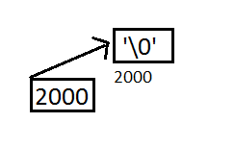
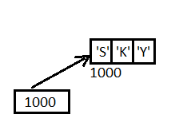
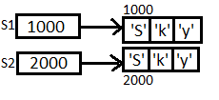
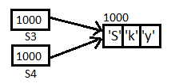
Constructors of String
String():- String S=new String();
String(String):- String S=new String(“Bhopal”);
Difference in Initialization:-
String s1=new String(“Sky”);
String s2=new String(“Sky”);
String s3=“Sky”;

Slide 6
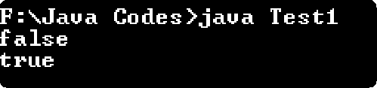
Constructors of String
• To check the memory diagram we can compare the object references,
String s1=new String(“Sky");
String s2=new String(“Sky");
String s3=“Sky";
String s4=“Sky";
System.out.println(s1==s2);
System.out.println(s3==s4);

Slide 7
Constructors of String
String(char[ ]):- Coverts a character array to String object.
String(char[ ],int1,int2):-
int1- Starting index
int2- Number of characters to be converted into String
char arr[ ]={‘H’, ‘e’, ‘l’, ‘l’, ‘o’};
String s=new String(arr,0,4);
System.out.println(s); Hell
• In java anything in “ ”(double quotes) is considered to be a string to be precise a
String object.
• Example :- “Bhopal”.length(); 6

Slide 8
Methods of String class
• public boolean equals(Object):- Derived from Object class. It compares object
references when object of any other class is passed. But it compares the strings when
a String is passed. So, every class can override equals in its own way.
• public boolean equalsIgnoreCase(String):- Method belongs to String class and ignore
case sensitivity.

Slide 9
Methods of String class
• public int compareTo(String):- Method belongs to String class and compares string and returns 0 if true else difference of their ASCIIs.
• public int compareToIgnoreCase(String):- Similar to above method but ignores case
sensitivity.
public int indexOf(int) :- Returns index of the character present in the string, which is
passed in the argument. If not found returns -1. It is a case sensitive method.
• public int indexOf(String):- Accepts a substring as argument and returns the beginning index where the substring occurs.
• public int length():- Gives length of string.

Slide 10
Methods of String class
• public char charAt(int):-Takes index number and gives character at that index.
public void getChars(int, int, char[ ], int):- Takes multiple characters and pastes their
copy to an array of characters.
public boolean startsWith(String):- Tests if this string starts with the specified prefix.
public boolean startsWith(String,int):- Tests if this string starts with the specified prefix beginning a specified index.
public boolean endWith(String):- Tests if this string ends with the specified suffix.

Slide 11
Methods of String class
• public int lastIndexOf(int):- Returns the index within this string of the last occurrence of the specified character.
• public int lastIndexOf(String):- Returns the index within this string of the rightmost
occurrence of the specified substring.
• public String substring(int, int):- Returns a new string that is a substring of this string.
The first argument is starting index for substring and second argument is end index-1 of the substring.
• public String substring(int):- Returns the substring from indexpassed as argument till
the last index of the string.

Slide 12
Methods of String class
• public String toUpperCase( ):- Converts all the characters of the String to upper case.
• public String toLowerCase( ):- Coverts all the characters of the String lower case.
There won’t be any change in the calling String object, just acopy of that String will be
returned.
• public static String valueOf(any primitive data type):- Returns the string representation of the passed data type argument.

Slide 13
Class StringBuffer
• The objects of class StringBuffer in java are mutable i.e. content of an object can be
changed without creating a new object.
• StringBuffer is used when data of a class may change in future. Example, Salary of
an employee.
• StringBuffer also has same methods as that of the class String except some of them.
• StringBuffer is also present in the package java.lang.

Slide 14
Constructors of StringBuffer
• public StringBuffer( ):- Creates an object with size 16 characters initialized with ‘\0’.
• public StringBuffer( int):- Creates a string buffer with specified capacity in the
argument and initialized with null character s.
• public StringBuffer( String):- The object is created and initialized with the string passed in the argument and is appended with 16 null characters(‘\0’).

Slide 15
Methods of Class StringBuffer
• public int capacity( ):- This method returns the current capacity. Using this method we can confirm the extra 16 characters reserved by java.
• public void ensureCapacity(int):- Increases capacity tothe argument passed.
• public StringBuffer append(String):- An overloaded function and can append any data
type.
StringBuffer s=new StringBuffer(“India”);
s.append(“is my country”);
System.out.println(s);

Slide 16
Methods of Class StringBuffer
• public StringBuffer reverse( ):- As the name suggests it reverses the original string.
start index, end index+1, new string
• public StringBuffer replace(int, int, String):- This method replaces the characters in a
substring of this sequence with characters in the specified String.
StringBuffer s=new StringBuffer(“Hello World”);
s.replace(6, 11, “India”);
System.out.println(s); Hello India
start index, end index+1, new string

Slide 17
Thank you

